Slide 1
Aquarium
Presented by:
Mahfuz rahman CSE 064 07577
MD. Ibrahim somir CSE 064 07522

Slide 2
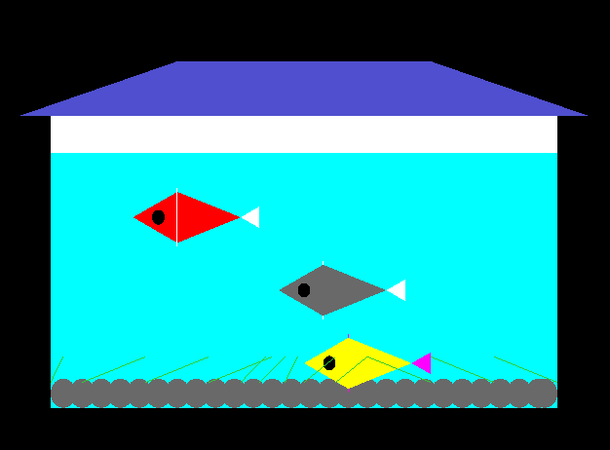
Aquarium

Slide 3
Aquarium objects:
Tank
Water
Fish
Plants
Stones

Slide 4
some feature of our project:
pressed left arrow key , all fishes are start moving.
Auto down all fishes.
pressed up arrow key, all fishes moving up.

Slide 5
Thanks.
Any question!?

